Slide 1
Software Design And Architecture (SE:2002) Design and Architecture

Slide 2
Design Principles:
The design process should not suffer from ‘tunnel vision.’
The design should be traceable to the analysis model.
The design should not reinvent the wheel.
The design should “minimize the intellectual distance” [DAV95] between the software and the problem as it exists in the real world.
The design should exhibit uniformity and integration.
The design should be structured to accommodate change.
The design should be structured to degrade gently, even when aberrant data, events, or operating conditions are encountered.
Design is not coding, coding is not design.
The design should be assessed for quality as it is being created, not after the fact.
The design should be reviewed to minimize conceptual (semantic) errors.

Slide 3
Quality Guidelines:
A design should exhibit an architecture that (1) has been created using recognizable architectural styles or patterns, (2) is composed of components that exhibit good design characteristics and (3) can be implemented in an evolutionary fashion
For smaller systems, design can sometimes be developed linearly.
A design should be modular; that is, the software should be logically partitioned into elements or subsystems
A design should contain distinct representations of data, architecture, interfaces, and components.
A design should lead to data structures that are appropriate for the classes to be implemented and are drawn from recognizable data patterns.
A design should lead to components that exhibit independent functional characteristics.
A design should lead to interfaces that reduce the complexity of connections between components and with the external environment.
A design should be derived using a repeatable method that is driven by information obtained during software requirements analysis.
A design should be represented using a notation that effectively communicates its meaning.

Slide 4
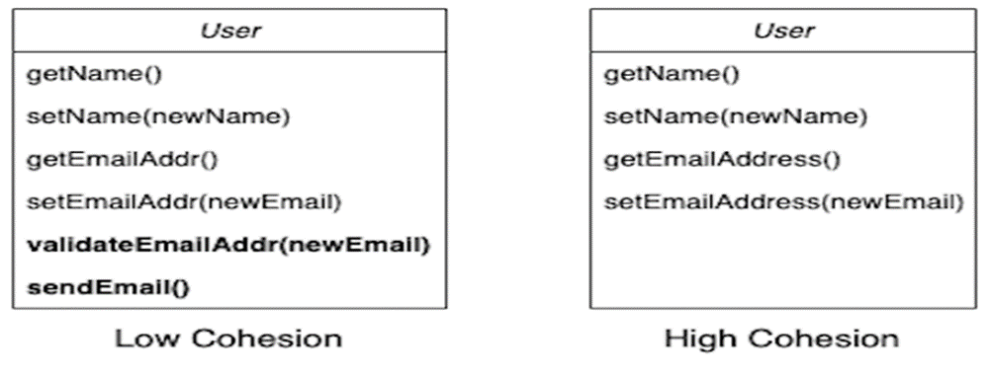
Functional Independence
Cohesion and Coupling deal with the quality of an OO design. Generally, good OO design should be loosely coupled and highly cohesive.
Cohesion is an indication of the relative functional strength of a module.
A cohesive module performs a single task, requiring little interaction with other components in other parts of a program.
Stated simply, a cohesive module should (ideally) do just one thing.

Slide 5
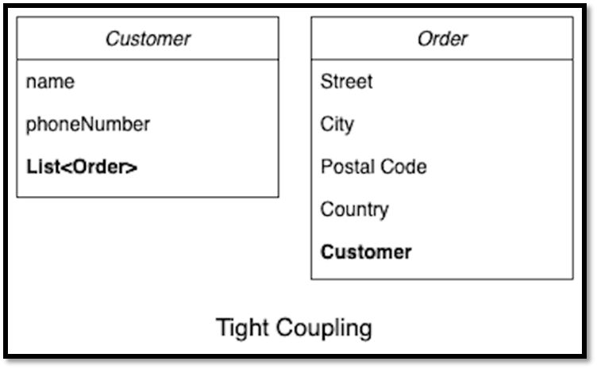
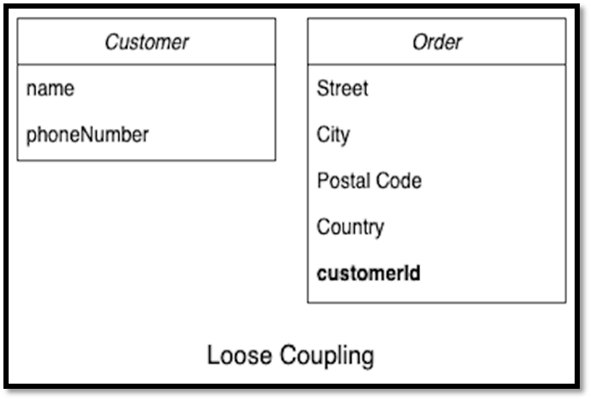
Coupling is an indication of the relative interdependence among modules.
Coupling depends on the interface complexity between modules, the point at which entry or reference is made to a module, and what data pass across the interface.

Slide 6
Architectural patterns

Slide 7
Architectural patterns
Patterns are a means of representing, sharing and reusing knowledge.
An architectural pattern is a stylized description of good design practice, which has been tried and tested in different environments.
Patterns should include information about when they are and when they are not useful.

Slide 8
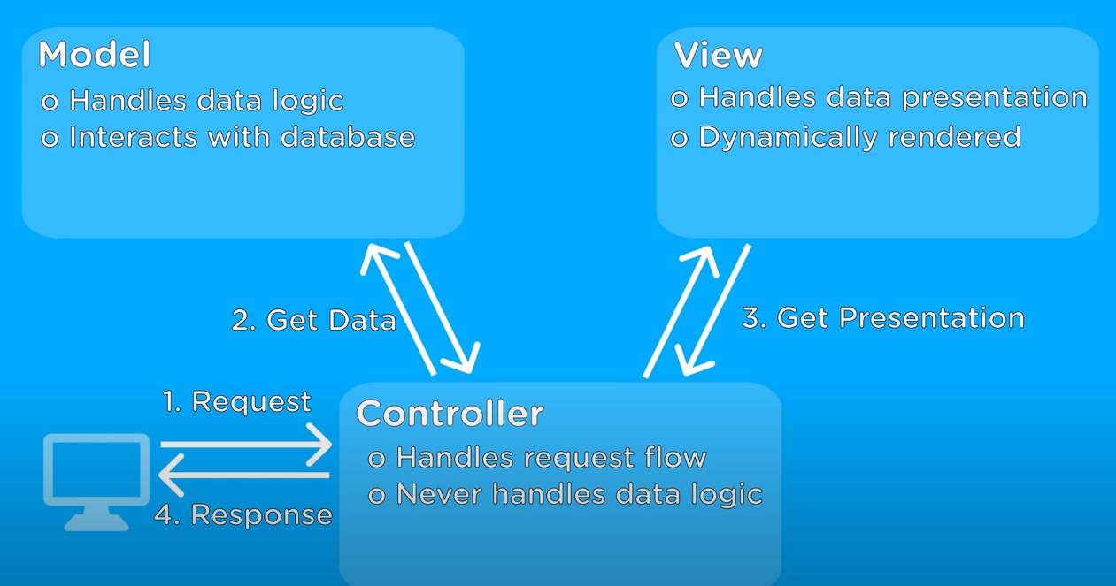
The Model-View-Controller (MVC) pattern

Slide 9
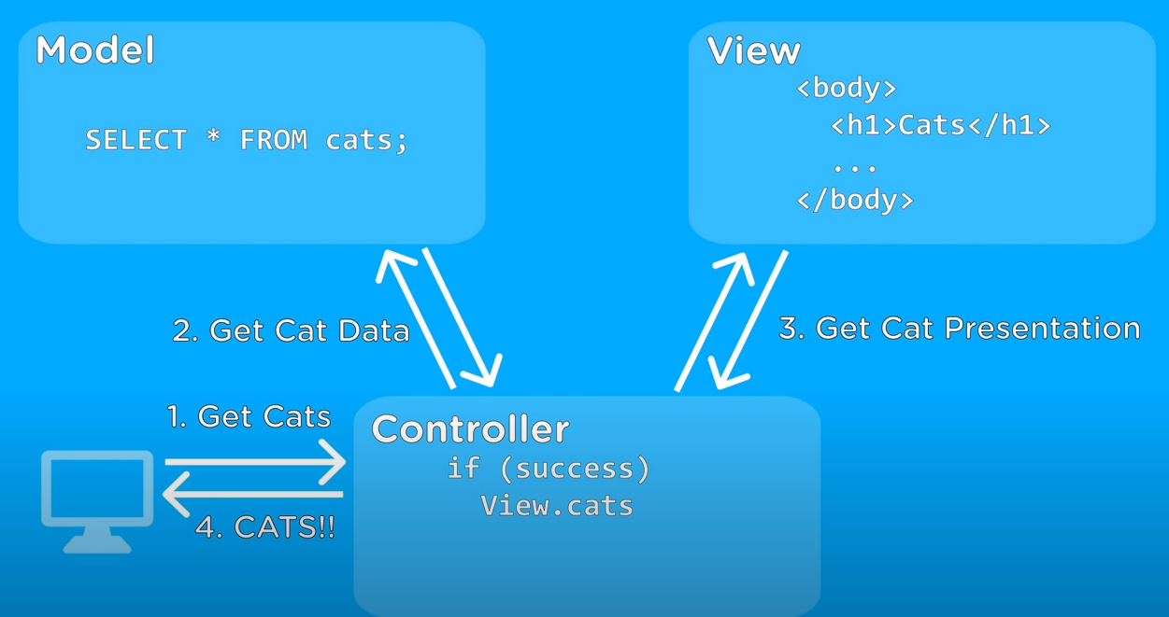
The Model-View-Controller (MVC) pattern
The goal of this pattern is to split a large application into specific section that has its own purpose.

Slide 10
Repository architecture
Data is stored in a central shared repository.
Components interact through the repository only.
Suited to applications whose data is generated by one component and used by another.
Data integrity, a database will ensure the data is accurate and consistent over its lifespan.
Advantages: -
Components are independent/separate.
Changes to data are automatically available to other components.
• Communication between components may be inefficient

Slide 11
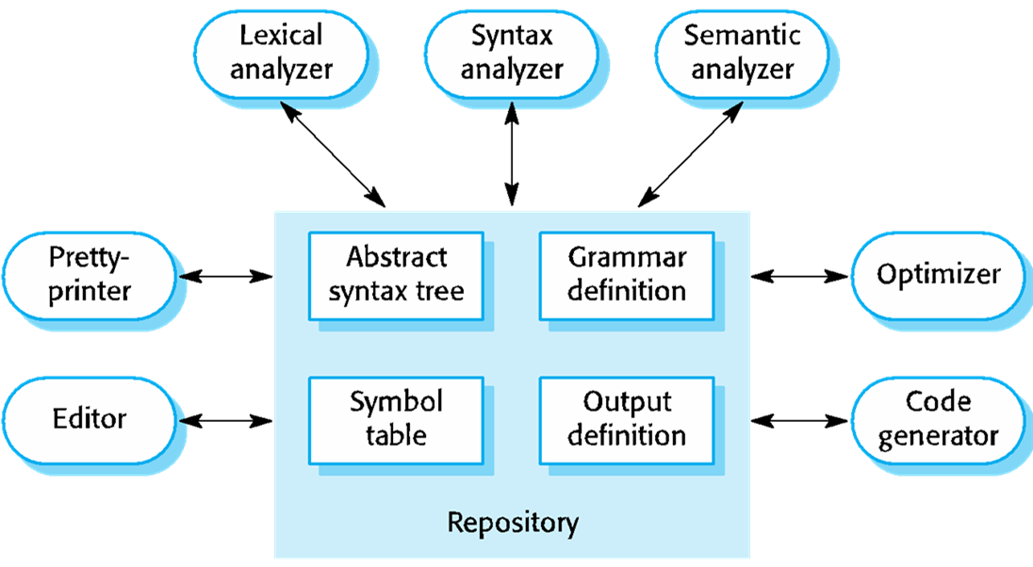
A repository architecture for a language processing system:

Slide 12
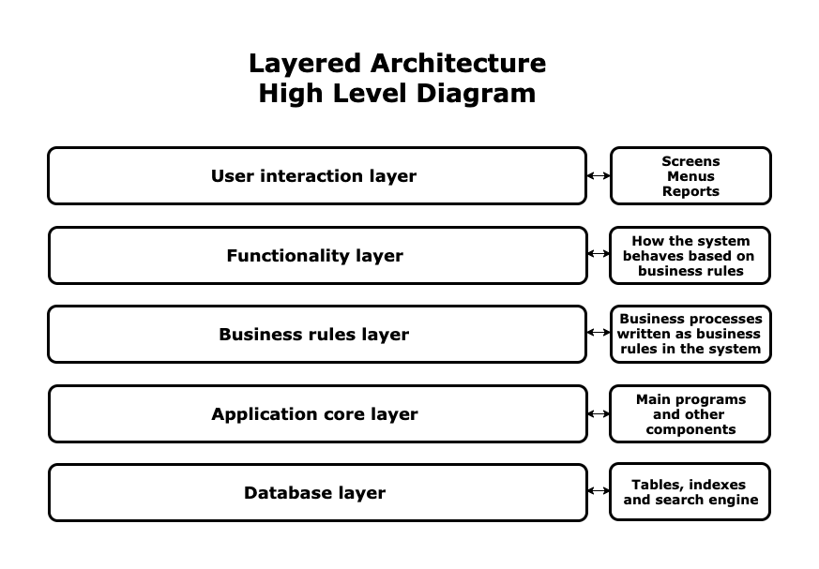
Layered architecture:
Tutorial Link for your reference:
https://www.coursera.org/lecture/software-architecture/3-2-4-layered-systems-ejXfx

Slide 13
The Layered architecture pattern
As you can see in the diagram above, a standard layered architecture has five parts:
User interaction layer: This is the layer that interacts with users through screens, forms, menus, reports, etc. It is the most visible layer of the application. It defines how the application looks.
Functionality layer: This is the layer that presents the functions, methods, and procedures of the system based on the business rules layer. It determines how the pull-down menus work, how the buttons work, and how the system navigates through screens.
Business rules layer: This layer contains rules that determine the behavior of the whole application, such as, “If an invoice is printed, then send an email to the customer, select all items sold, and decrease their stock in the stock management module.”
Application core layer: This server contains the main programs, code definitions, and basic functions of the application. Programmers work in this layer most of the time.
Database layer: This layer contains the tables, indexes, and data managed by the application. Searches and insert/delete/update operations are executed here.

Slide 14
Client-server architecture:
Front-End: This is the piece of software that interacts with users, even if they are on different platforms with different technologies. Any front-end module in a client-server architecture is designed to interact with all existing devices on the market. This level contains the login screens, menus, data screens.
Application server: This is the server where the software modules of the application are installed. It connects to the database (called back-end) and interacts with users (called front-end). The application server is like the waiter on our restaurant example.
Database server: This server contains the tables, indexes, and data managed by the application. Searches and insert/delete/update operations are executed here.
Tutorial Link for your reference:
https://www.coursera.org/learn/software-architecture/lecture/arPU8/3-2-5-client-server-n-tier

Slide 15
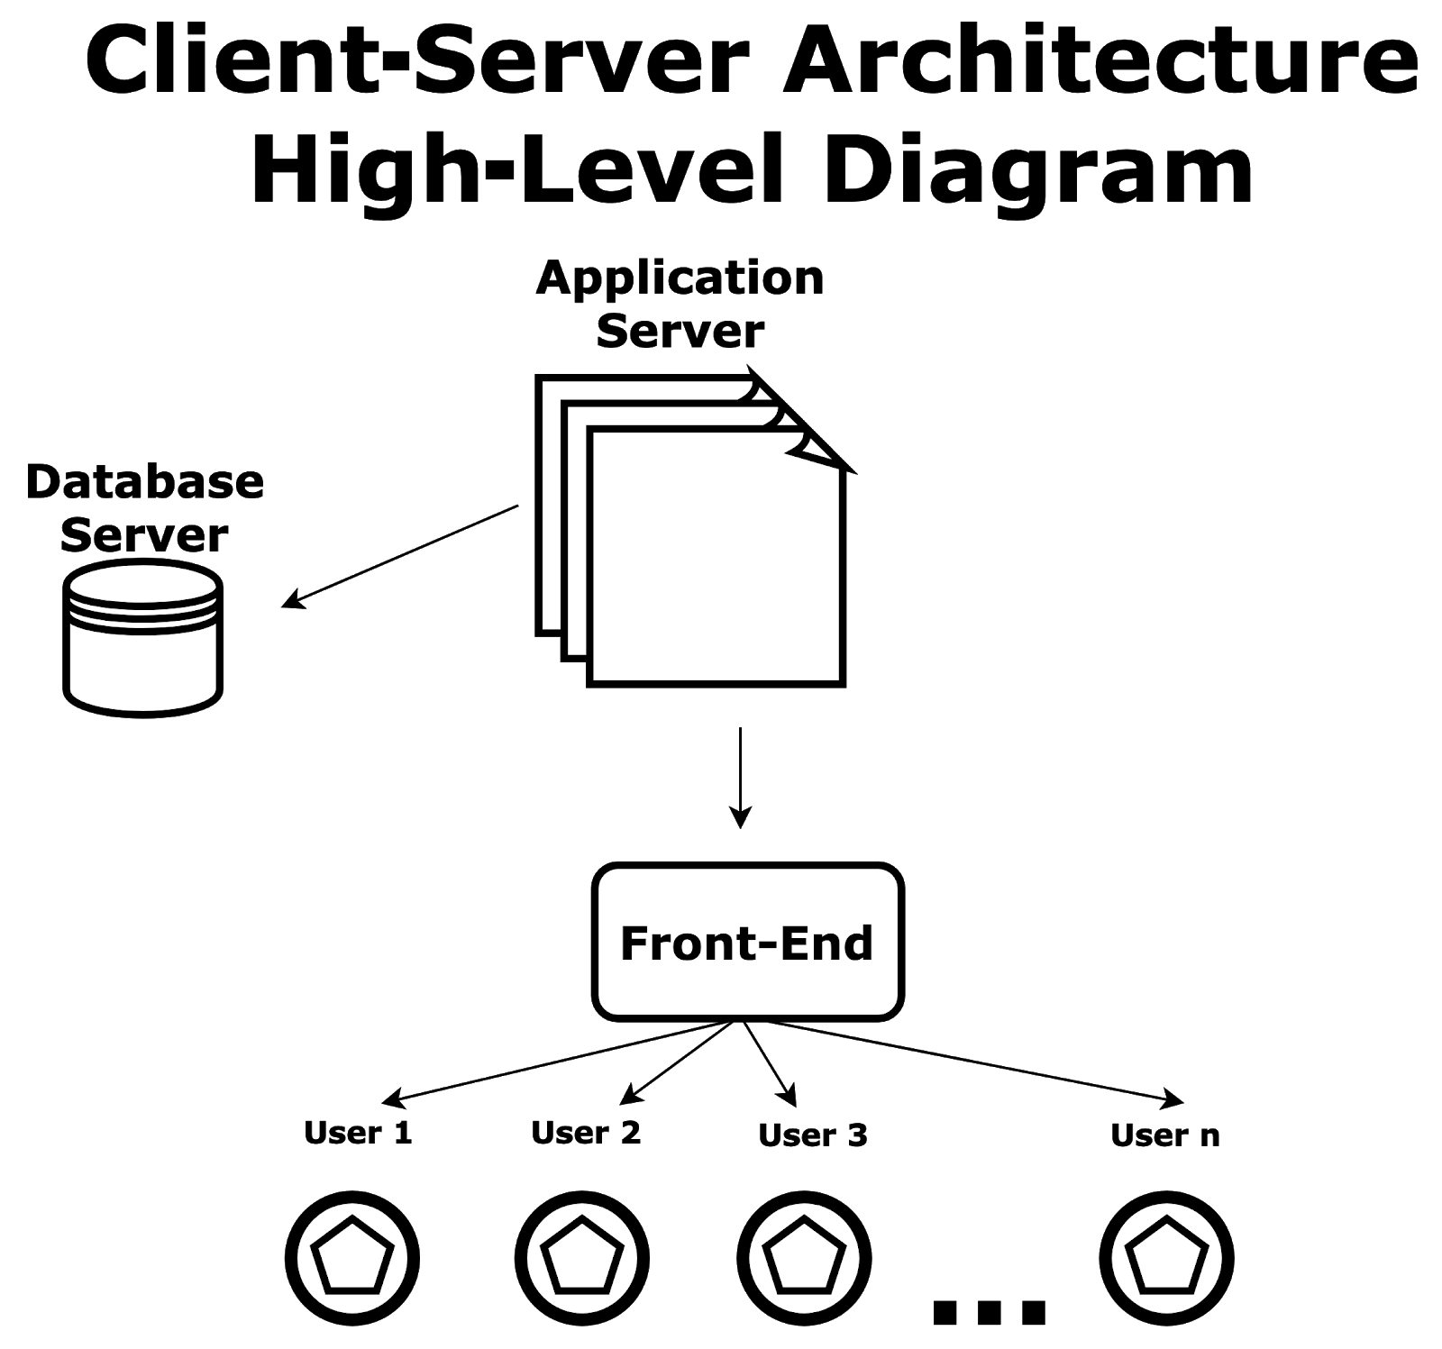

Slide 16
Pipe and filter architecture
Functional transformations process their inputs to produce outputs.
Variants of this approach are very common. When transformations are sequential, this is a batch sequential model which is extensively used in data processing systems.
Not really suitable for interactive systems.
Tutorial Link for your reference:
https://www.coursera.org/learn/software-architecture/lecture/bYHgh/3-2-7-pipes-and-filters

Slide 17
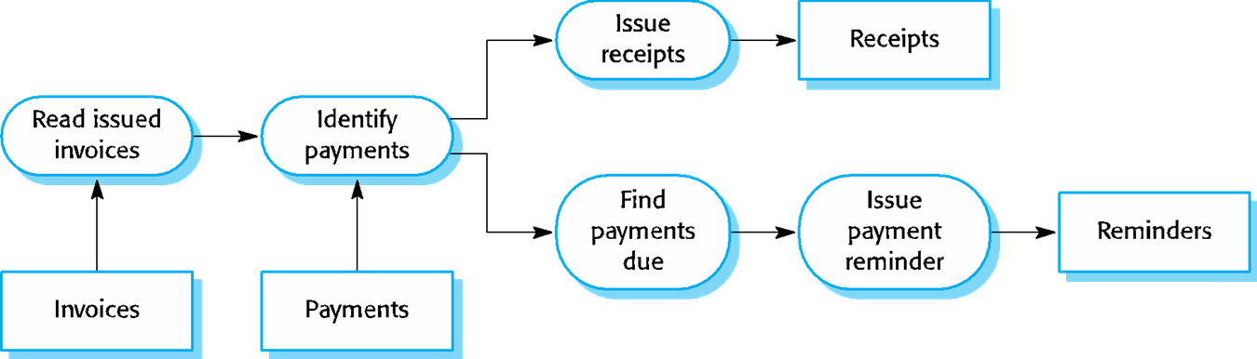
An example of the pipe and filter architecture used in a payments system :

Slide 18
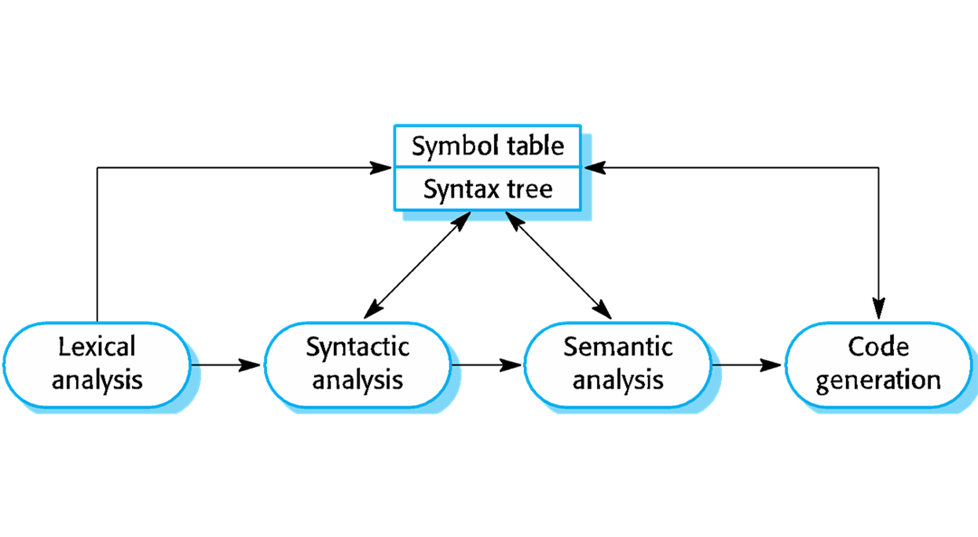
A pipe and filter compiler architecture

